Slide 1
15 Test Taking Strategies Every Test Taker Should Know

Slide 2
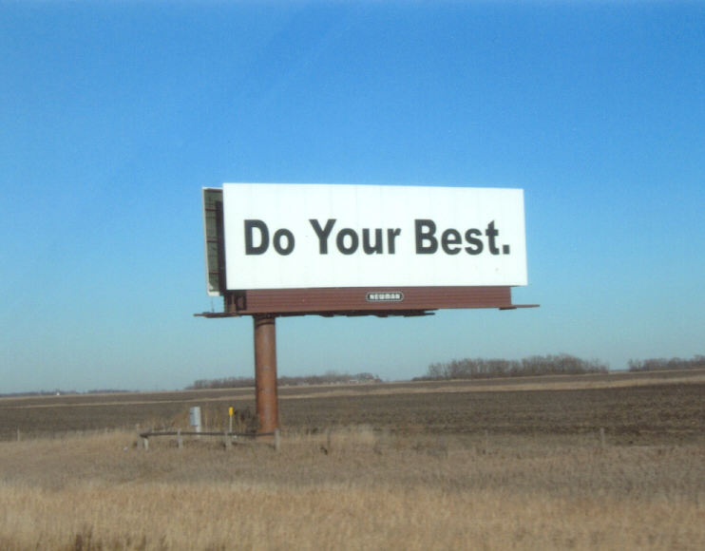
ON THE TEST!

Slide 3
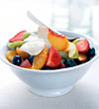
Test Taking Strategy # 1–
Get plenty of rest the night before each testing day
You need 8-10 hours of sleep, so go to bed by 10pm.
Get ready before testing
Eat a good nutritious breakfast the morning of each testing day
(Milk w/cereal, eggs, fruits; no Hot Cheetos and candy.)
Avoid the morning rush. Set out clothes the night before. Get to school a few minutes earlier than you usually do.

Slide 4
Can You Follow Directions? Get Out a Sheet of Paper and Take This Test.
CAN YOU FOLLOW DIRECTIONS?
This is a timed test--you have 3 minutes only!
1. Read everything carefully before doing anything.
2. Put your name in the upper right-hand corner of this paper.
3. Loudly call out your first name.
4. Circle your name.
5. If you have followed directions carefully to this point, call out "I have.”
6. Draw five small squares in the upper left-hand corner.
7. Put an "X" in each square.
8. In your normal speaking voice, count from ten to one backwards.
9. Now that you have finished reading everything carefully, do only sentences one and two.

Slide 5
Test Taking Strategy # 2
Always listen to the directions given by teacher.
LISTEN
Read the directions written on the test.
Read the question and ALL answer choices before marking anything.
READ
ASK
Follow Directions!

Slide 6
Test Taking Strategy # 3
Use your time wisely!
1. Don’t spend too much time on any one question.
2. It is important to answer every question even if you are not sure of the answer.
5. Answer the easiest questions first, but be sure to go back to those questions you skipped.
4. Save time at the end to review your test and make sure you haven't left out any answers.
3. Use all your time! There are no extra points for finishing early.

Slide 7
PACE YOURSELF
REMEMBER TO DO THE EASIEST PROBLEMS FIRST
AND THEN BE SURE AND GO BACK!

Slide 8
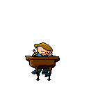
Test Taking Strategy # 4
If you can’t figure out which answer is correct, try to eliminate (get rid of) the answers that you know are wrong.
Eliminate obviously wrong answer choices
Eliminate choices that are partly correct
Eliminate items that are correct but don’t answer the question
Elimination

Slide 9
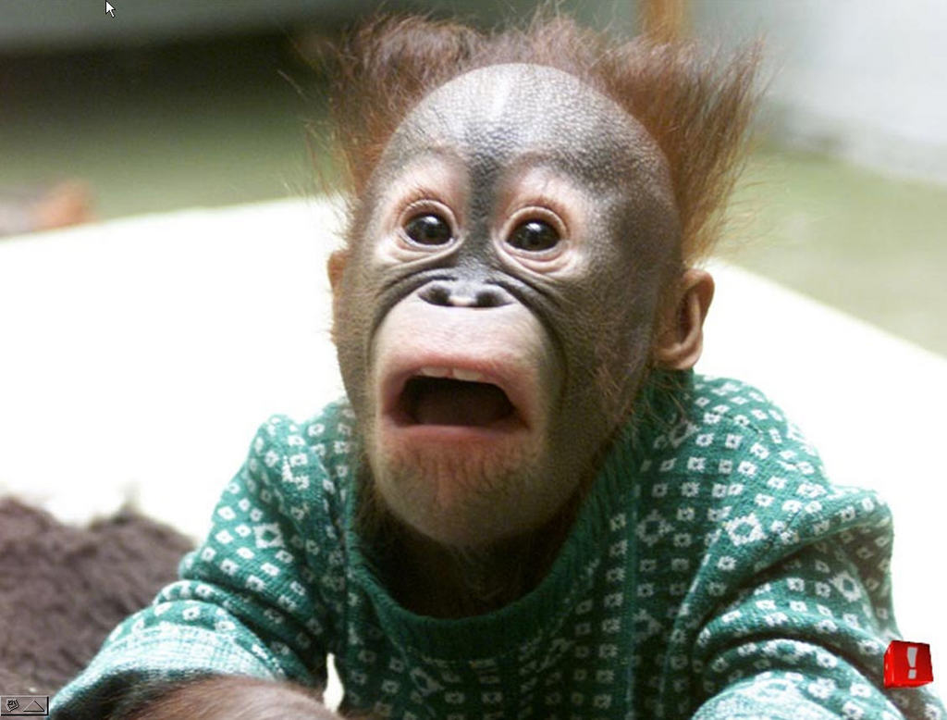
Test Taking Strategy # 5
Educated guessing means using everything you know to attempt to answer the question.
A random guess gives you a 25% chance of getting the right answer. An educated guess gives you chance of answering correctly up to 75% .
Educated Guess

Slide 10
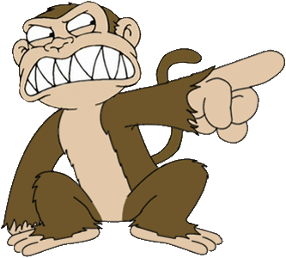
Test Taking Strategy # 6
ANSWERS WITH THE FOLLOWING WORDS ARE USUALLY WRONG/FALSE.
ALL ALWAYS
MUST NONE
NEVER EVERY
ENTIRELY BEST WORST ONLY
EVERYONE
ABSOLUTE WORDS

Slide 11
Test Taking Strategy # 7
ANSWERS WITH THE FOLLOWING WORDS ARE USUALLY CORRECT/TRUE
SOME SOMETIMES GENERALLY
USUALLY
FREQUENTLY PROBABLY
MOST FEW MANY OFTEN SELDOM
GENERAL WORDS

Slide 12
Test Taking Strategy # 8
The context of a word includes all the words and sentences that surround it and the situation in which the word is used.
WHEN THE ANSWER IS NOT CLEAR, LOOK FOR CLUES ( CONTEXT, TENSE, WORD TYPE, GRAMMAR) IN THE QUESTION AND THE ANSWER CHOICES
LOOK FOR CLUES

Slide 13
Test Taking Strategy # 8 continue...
Clue words in test questions:
Who? Person What? Thing
Where? Place When? Time Why? Reason Which? Choice
How? A way something is done
How many ? Number
LOOK FOR CLUES

Slide 14
Example
Our class will see a play,__________ends this week.
Who
What
Which
When
1.Use elimination strategy first…
2. Look for a clue
3. Play is a noun in this sentence, so ask yourself what kind of a play it is.

Slide 15
Test Taking Strategy # 9
The effect of negatives is to make the sentence the opposite of what it would be without the negative.
Simplify the question by getting rid of double negatives.
Simplify this statement: Most people are
not unafraid of snakes.
Most people are
afraid of snakes.
Negatives:
Not None No one
Hardly Scarcely
Prefixes such as
Un- Non- Dis- In-
NEGATIVES & DOUBLE NEGATIVES

Slide 16
Example
Mrs. Smith dislikes when students are being rude to their teachers.
Without changing the meaning of the sentence, which words can best be used to replace the underlined part?
Enjoys
Tolerates
Punishes
Does not like

Slide 17
Test Taking Strategy # 10
In Math, ESTIMATING is an approximate answer
obtained by rounding the numbers BEFORE you
add, subtract, multiply, or divide.
Always ask yourself: “Is the answer reasonable?”
For example:
What is 325+917+ 796?
A. 56 B. 2038 C. 1038 D. 10,564
Estimate

Slide 18
Examples
What value of N makes the equation true?
N-19=33
Eliminate obviously wrong answers first and then
estimate!
245
42
14
52

Slide 19
Example An airplane flew 2905 miles in 5 hours. What was the speed of the plane?
A. 12 miles per hour
B. 2324 miles per hour
C. 581 miles per hour
D. 481 miles per hour

Slide 20
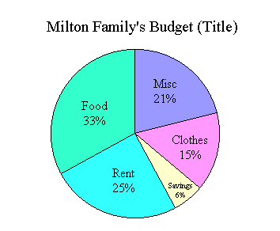
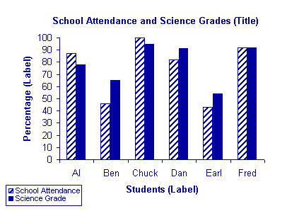
Test Taking Strategy # 11
1. Read all the titles, labels, and other given information
Check the units of measurement
Look for a pattern, trend, or comparison in the graph or table
Questions with graphs, charts, and tables,

Slide 21
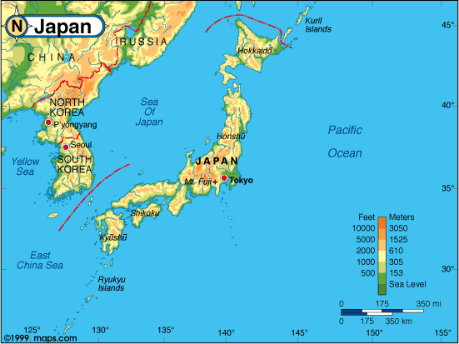
Test Taking Strategy # 12
Read the title of the map
Check the map key( legend)
Look at the map scale (if you
need to find a distance)
4. Re-read the question again
Questions with maps

Slide 22
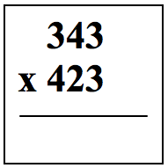
Other Math Tips
Use Scratch Paper.
Double Check To Make Sure You've copied the problem correctly.
Line Up Place Values (thousands, hundreds, tens, ones) Neatly To Avoid Careless Mistakes.
Pace Yourself.
MOVE ON AND
GO BACK!

Slide 23
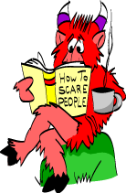
Test Taking Strategy # 13
Answers about where and when the story takes place are found at the beginning.
Answers about a problem of the story are usually found in the middle.
Answers about how the problem was resolved are usually found at the end.
Reading a story

Slide 24
When Reading a Passage Remember To:
READ THE QUESTIONS FIRST to determine what you are looking for as you read the selection.

Slide 25
Test Taking Strategy # 14
What’s the Big Idea?
Events and characters that make up the story
The purpose of the story
The point the author is trying to make
Tip: Look for the Big idea in the first two paragraphs of the story!
Finding the BIG IDEA

Slide 26
Example
Read this outline of the article.
Introduction
Athenian Democracy
Representative Democracy
Conclusion
Which main idea belongs first under section III?
Every citizen is a member of a government
A presidential election is like a town meeting
Al Gore got about 500,000 more votes than George Bush did
A few elected officials represent a very large population
Use all the strategies you have learned

Slide 27
KNOW THE MEANING OF THESE 12 POWER WORDS
*Trace-outline, list in steps, or follow the
path
*Analyze-break into parts, tell about the
parts
*Infer-read between the lines, what is the
hidden meaning
*Evaluate-judge it, tell the good and the
bad

Slide 28
KNOW THE MEANING OF THESE 12 POWER WORDS Continued
*Formulate-create, put together
*Describe-tell about, paint a picture with
words
*Support-back it up or prove it with
details
*Explain-teach me or show me the
steps

Slide 29
KNOW THE MEANING OF THESE 12 POWER WORDS Continued
*Summarize-tell the main idea, tell the
beginning, middle, and end
*Compare-tell the all the ways they are
the same
*Contrast-tell all the ways that they are
different
*Predict-What will happen next?

Slide 30
Test Taking Strategy # 15
Don’t misbubble
If you reach a hard question and can’t make your educated guess, an easier one is just around the corner. Write a light ? next to the question you are skipping and move on to the next question.

Slide 31
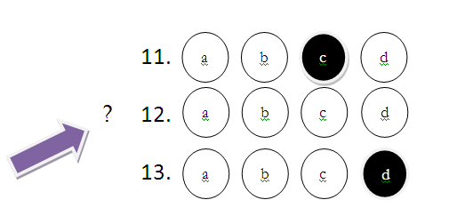
How Do You Prevent Misbubbling?
At the end of the test, go back to the questions with ? next to them and see if you can try to answer it. Please be sure to answer every question.

Slide 32
Final Tip Reminders
If the test requires you to read passages and then answer questions about what you read,
Read the questions first.
Line up place value correctly on
your scratch paper (thousands, hundreds, tens, ones).
Remember: Never leave any question on a test blank.

Slide 33
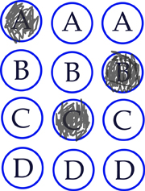
When You Are Done …
Fill in bubbles fully, write neatly, and erase stray marks.
If you finish early, check to make sure you have answered all questions.
Once you have finished, please remain quiet as others will still be working on the test.

Slide 34
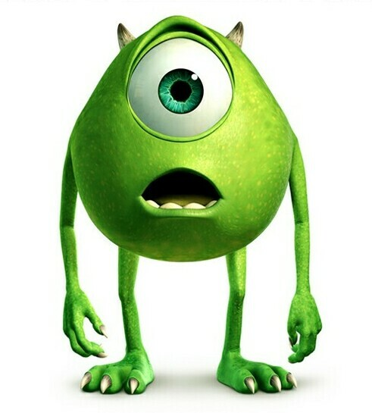
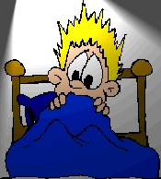
Remember…
I am scared of the test monster!!!!
Remember the strategies! They will help you to feel confident.
Think positively about doing your best!
Take a deep breath to relax.
Answer EVERY question.
Make intelligent educated guesses.
Think about one item at a time.
DO YOUR BEST!
Follow these tips to reduce your anxiety!

Slide 35
Reduce Your Test Anxiety With Practice
Confidence comes from practice and becoming familiar with the format.
USATestprep will give you the practice you need to help you stay calm and do your best.

Slide 36
By Using The Test Taking Strategies You Have Learned Today, and With Practice, You Can Improve Your Test Taking Skills and Test Scores. YOU CAN DO THIS!
Sources:
“Preparing Middle School Students for High Stakes Tests,” Tara Musslewhite, Atascocita Middle School, Humble, Texas
“15 Strategies Every Test Taker Should Have,” Vista Middle School, Van Nuys, CA

