Slide 1
Youscience
Please login to your computer and login to Parent Portal

Slide 2
What is Youscience?
Youscience is a series of questions to help you determine what career or trade is the “BEST FIT” for you after high school
IMPORTANT: The Hiram High School Magnet program uses the results from Youscience to identify students who may be a good fit for their Magnet Program in 9th grade that focuses on Computer Science and STEAM/STEM

Slide 3
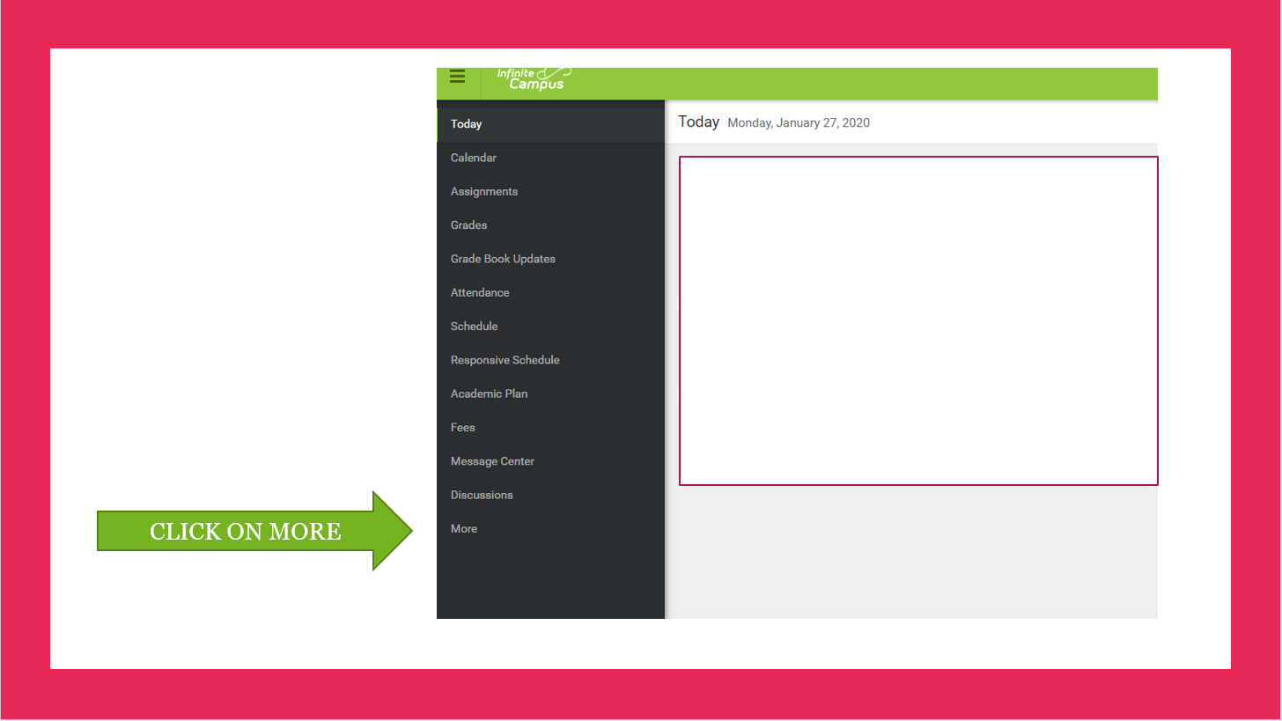

Slide 4
Click on SLDS Portal

Slide 5
Click on “My Career Plan”

Slide 6
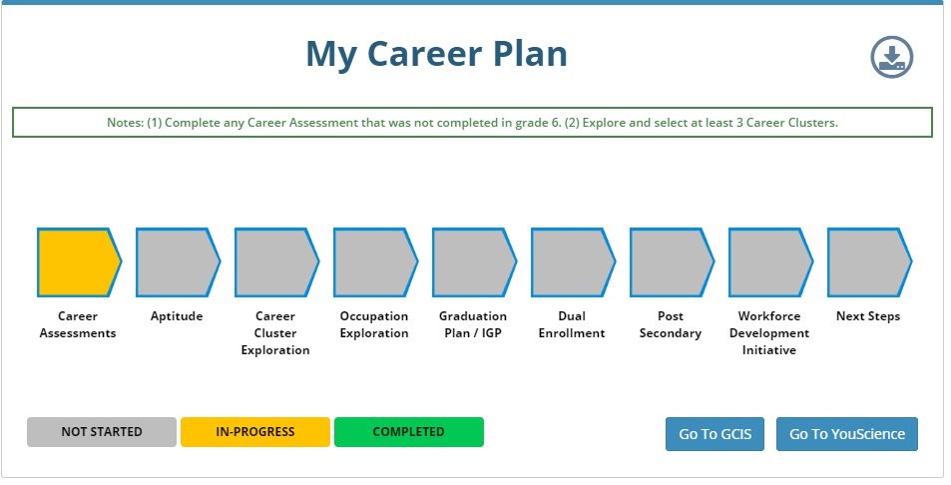
Click on Youscience

Slide 7
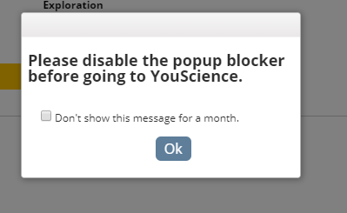
Click “OK” to disable popup blocker (if you get this message)
If screen does not pop up in the search bar you will see a red box showing pop
Up was blocked. Click on this and click “Allow Popup”

Slide 8
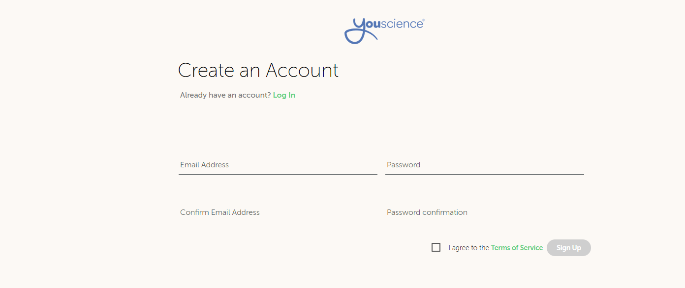
You MUST enter your information as below:
Email address should be:
yourstudentnumber@Paulding.k12.ga.us
Password should be same as your computer login.
Email address:123456@paulding.k12.ga.us
Confirm email address:123456@paulding.k12.ga.us
CLICK

Slide 9
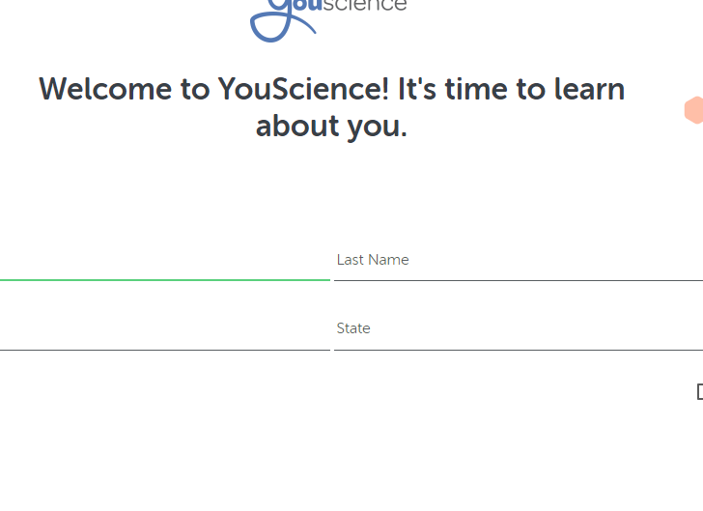
Enter your LEGAL first and last name
Zip Code:
State:
GA
Use your legal first and last name
If you don’t know your zip code, use the school zip code

Slide 10
Enter the school phone number and complete the remaining information
Enter the requested information above

Slide 11
Enter your school name as below:
Type in your school name

Slide 12
Choose the block which best describes what you think your plan will be it is okay to choose “not quite sure yet”

Slide 13
Click on “Let’s Get Started”

Slide 14
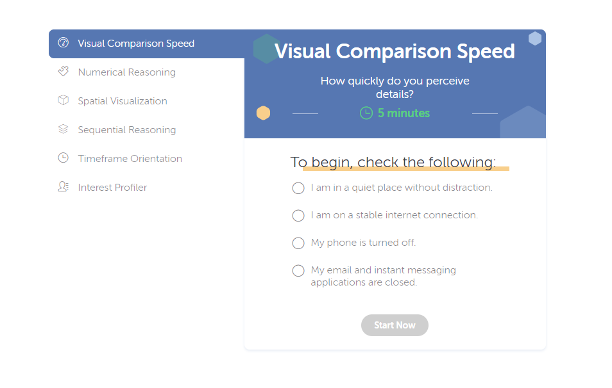
Check Each Box
Click “START NOW”

